Slide 1
Decisions One or Two Outcomes
ICS 3U0

Slide 2
Today’s Agenda
Decisions with ONE outcome using IF statements
Decisions with TWO outcomes using IF ELSE statements

Slide 3
Making Decisions in Python
For our programs to become more useful, we need to start making decisions.
Suppose we want to decide somewhere in our program, “Is the user old enough to vote?”

Slide 4
Conditions
Conditions are statements that can be tested as either TRUE or FALSE.
input age
if (age is 18 or over) then “You can vote!”
if (age is under 18) then “You cannot vote.”
This is an example of pseudocode, where we use plain language, but it looks a bit like computer code.

Slide 5
Example – Voting Age Design Using Comments
As programs get more complicated, start by using comments to build a framework to solve the problem:
For example:
# Ask the user's age
# If they are 18 or older, they can vote
# If they are under 18, they cannot vote

Slide 6
Example – Voting Age Add Easy Code
# Ask the user's age
age = int(input("How old are you? "))
# If they are 18 or older, they can vote
print("You can vote!")
# if they are under 18, they cannot vote
print("You are not old enough to vote!")

Slide 7
Example – Voting Age Add New Code
# Ask the user's age
age = int(input("How old are you? "))
# If they are 18 or older, they can vote
if age >= 18:
print("You can vote!")
# if they are under 18, they cannot vote
if age < 18:
print("You are not old enough to vote!")

Slide 8
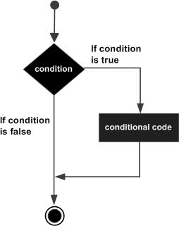
IF Statement
Example 1
What is the expected output of this code?
age = 23
if age >= 18:
print("You are old!")
Example 2
What is the expected output of this code?
age = 15
if age >= 18:
print("You are old!")

Slide 9
Example – Voting Age Another Way!
# Ask the user's age
age = int(input("How old are you? "))
# if they are 18 or older, they can vote
if age>= 18:
print("You can vote!")
else:
# if they are under 18, they cannot vote
print("You are not old enough to vote!")

Slide 10
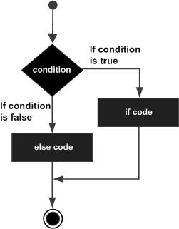
IF ELSE Statement
Example 1
What is the expected output of this code?
grade = 23
if grade >= 75:
print("You did great!")
else:
print("Better luck next time!")
Example 2
What is the expected output of this code?
grade = 100
if grade >= 75:
print("You did great!")
else:
print("Better luck next time!")

Slide 11
Comparison Operators
Making a decision using selection requires a comparison between two quantities or values. Each comparison will use one of the comparison operators listed below.
< less than
<= less than or equal to
> greater than
>= greater than or equal to
== equal to
!= not equal to

Slide 12
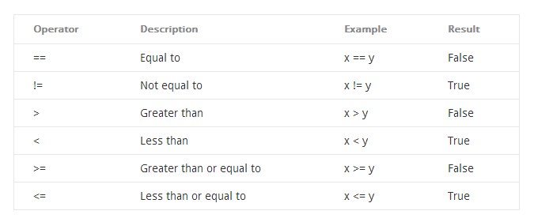
Comparison Operators - Example
Let’s assume for this example that x=10 and y=20

Slide 13
Exercises – Decisions One or Two Outcomes
Complete Exercise 2.1 –
Day 1 Decisions - One or Two Outcomes
Day 2 Decisions - One or Two Outcomes

